Slide 1
PHP in depth 9
3870

Slide 2
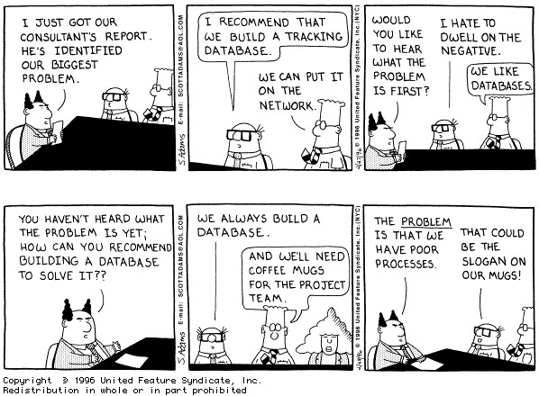

Slide 3
Migrations 1
// creating migrations
$ php artisan migrate:make create_users
$ php artisan migrate:make create_users --create --table=users

Slide 4
Migrations 2
// build schema
$ php artisan migrate
// rollback
$ php artisan

Slide 5
Build Schema in Migration
Schema::create('albums', function($table)
{
$table->increments('id');
$table->string('title', 256);
$table->string('artist', 256);
$table->string('genre', 128);
$table->integer('year');
});
Schema::drop('albums');

Slide 6
Eloquent model
<?php
class Location extends Eloquent
{
//you need the following
public $timestamps = false;
}

Slide 7
Seeding database 1
<?php
// app/routes.php
Route::get('/seed', function()
{
$album = new Album;
$album->title = 'Some Mad Hope';
$album->artist = 'Matt Nathanson';
$album->genre = 'Acoustic Rock';
$album->year = 2007;
$album->save();
$album = new Album;
$album->title = 'Please';
$album->artist = 'Matt Nathanson';
$album->genre = 'Acoustic Rock';
$album->year = 1993;
$album->save();
});

Slide 8
Seeding database 2
// in migration
DB::table('albums')->insert(array(
'title' => '',
'artist' => '',
'genre' => '',
'year' => 2014
));

Slide 9
Simple query 1
<?php
// app/routes.php
Route::get('/', function()
{
$album = Album::find(1);
return $album->title;
});

Slide 10
Simple query 2
<?php
// app/routes.php
Route::get('/', function()
{
return Album::all();
});

Slide 11
Simple query 3
<?php
// app/routes.php
Route::get('/', function()
{
return Album::find(array(1, 3));
});

Slide 12
Delete
<?php
// app/routes.php
Route::get('/', function()
{
Album::where('artist', '=', 'Matt Nathanson')
->delete();
return Album::all();
});

Slide 13
Delete all
<?php
// app/routes.php
Route::get('/', function()
{
Album::truncate();
return Album::all();
});

Slide 14
Get
<?php
// app/routes.php
Route::get('/', function()
{
return Album::where('artist', '=', 'Something Corporate')
->get();
});

Slide 15
Get 2
<?php
// app/routes.php
Route::get('/', function()
{
return Album::where('artist', '=', 'Something Corporate')
->get(array('id', 'title'));
});

Slide 16
Pluck
<?php
// app/routes.php
Route::get('/', function()
{
return Album::pluck('artist');
});

Slide 17
List all entries for column
<?php
// app/routes.php
Route::get('/', function()
{
return Album::lists('artist');
});

Slide 18
return first result
<?php
// app/routes.php
Route::get('/', function()
{
return Album::where('artist', '=', 'Matt Nathanson')
->first();
});

Slide 19
like clause
<?php
// app/routes.php
Route::get('/', function()
{
return Album::where('title', 'LIKE', '...%')
->get();
});

Slide 20
where/or where
<?php
// app/routes.php
Route::get('/', function()
{
return Album::where('title', 'LIKE', '...%')
->orWhere('artist', '=', 'Something Corporate')
->get();
});

Slide 21
where between
<?php
// app/routes.php
Route::get('/', function()
{
return Album::whereBetween('year', array('2000', '2010'))
->get();
});

Slide 22
nested where
<?php
// app/routes.php
Route::get('/', function()
{
return Album::whereNested(function($query)
{
$query->where('year', '>', 2000);
$query->where('year', '<', 2005);
})
->orWhere(function($query)
{
$query->where('year', '=', 1997);
})
->get();
});

Slide 23
Further reading
Read end of:
http://daylerees.com/codebright/eloquent-queries
for more features

Slide 24
Exercise
Clone ggc-talk and have it running on your desktop
https://github.com/ggc-itec/ggc-talk

Slide 25
Exercise
Reimplement your YQL(Yahoo Query Language) assignment using Laravel framework

